Slide 1
Ambiguous Genitalia
Anne Reynolds Tessa Coan Josh Werema
Table 2

Slide 2
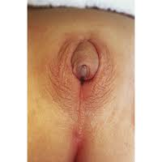
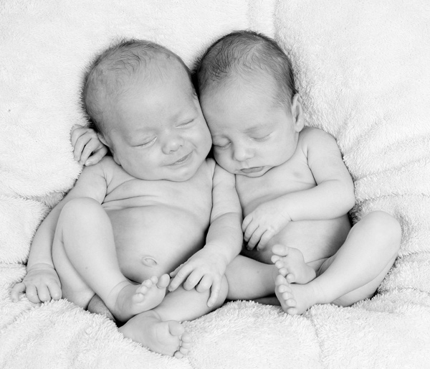
What is Ambiguous Genitalia?
Ambiguous Genitalia is diagnosed at birth or in the weeks following. It is the deformity of the external genitalia. Doctors have difficulty differentiating between the male and female sex organs. Usually this is caused by a hormone imbalance in the body.

Slide 3
Ambiguous Genitalia in Genetic Females
Enlarged clitoris looks like a small penis
Urethral opening can be along, above, or below surface of the clitoris
Labia may look like a scrotum
Infant may be thought to be a male with testicles that have not descended
Lump of tissue may be felt in the labia, making it look like a scrotum with testicles

Slide 4
Ambiguous Genitalia in Genetic Males
Small penis that looks like an enlarged clitoris
Urethral opening may be along, above, or below the penis
  Can be as low as on the peritoneum, making the infant appear to be female
Possibly a small scrotum that is separated, looks like labia.
Testicles that are not descended are a common occurrence

Slide 5
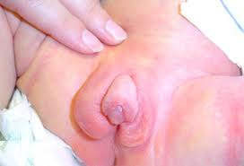
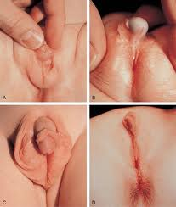
What does it look like?

Slide 6
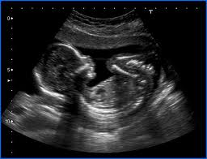
General Causes
Ambiguous Genitalia often occurs along with a DSD or Disorders of Sex Development
Lack of male hormones in a genetic male fetus
Exposure to male hormones in a genetic female fetus

Slide 7
Possible Causes for Males
Impaired Testicle Development
Congenital Adrenal Hyperplasia (CAH)
  Can impair production of male hormones
Androgen Insensitivity Syndrome
  Developing genital tissues don't respond normally to male hormones
Abnormalities with Testes or Testosterone
5-Alpha-Reductase Deficiency.
  Enzyme defect that impairs normal male hormone production.
Prenatal Exposure to Substances with Female Hormone Activity
  Example: Birth Control

Slide 8
Possible Causes for Females
Congenital adrenal hyperplasia (CAH)
  Can cause the adrenal glands to make excess male hormones.
  CAH-most common cause of DSD
Prenatal Exposure to Substances with Male Hormone Activity
  Example: Anabolic Steroids
Tumors
  Rare, but a tumor may produce male hormones

Slide 9
Treatment

Slide 10
Statistics

Slide 11
Citations
http://www.askdro.com/2011/03/woman-carries-dead-fetus-drug-testing-for-welfare-more/
http://indianpediatrics.net/may2004/may-512.htm
http://health.nytimes.com/health/guides/symptoms/ambiguous-genitalia/overview.html
http://medical-dictionary.thefreedictionary.com/Ambiguous+Genitalia
http://smashinghub.com/30-beautiful-baby-photos.htm
http://www.mayoclinic.com/health/ambiguous-genitalia/DS00668/DSECTION=causes

